Slide 1


micro:bit入门视频教程
Lesson 18
micro:bit creative lesson 18 “Lesson 18 Ball small light”
亚博智能 micro:bit视频教程

Slide 2

micro:bit entry video tutorial
Content
Part1
Part 2
Part3
Part 4
Part 5
Learning goals
Preparation
Handmade
Search for blocks
Combine blocks
YahBoom micro:bit creative tutorial

Slide 3
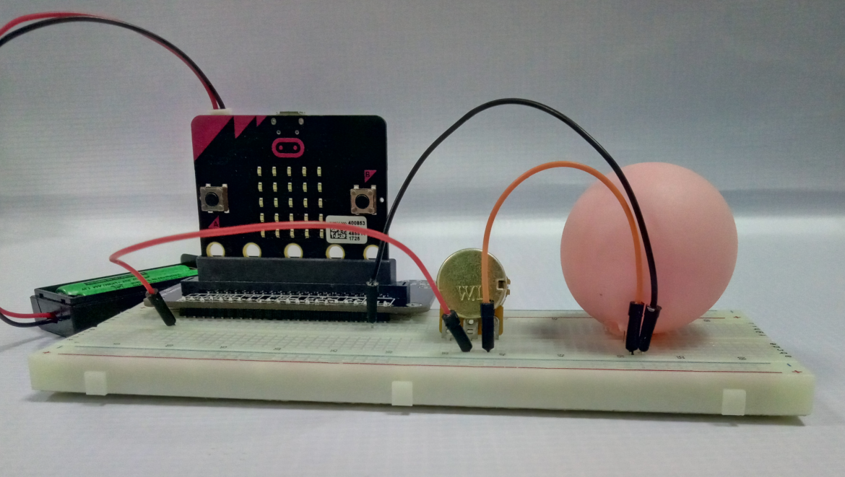
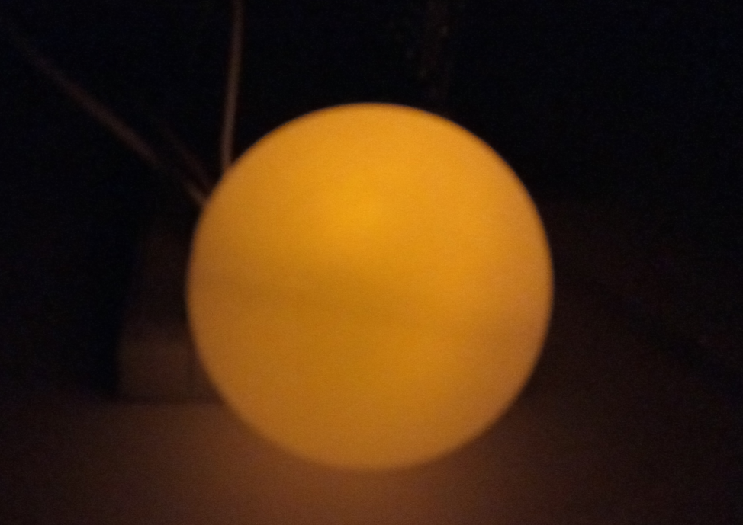
micro:bit entry video tutorial
Part 1
Learning
goals
After you download the program, turn the adjustable knob to change the brightness of the small light.
Turn off the lights in the room, it will be more beautiful~
Just like in the picture in the upper right corner. Is it like a round moon?
YahBoom micro:bit creative tutorial

Slide 4
micro:bit entry video tutorial
Part 2
Hardware:
● 1 x Micro:bit Board
● 1 x Micro:bit expansion board
● 3 x DuPont line male to male
● 1 x LED
● 1 x Adjustable knob
● 1 x Breadboard
● 1 x Table tennis with holes
● 1 x PC
● 1 x USB Cable
Preparation
Then the micro:bit is connected to the computer through USB,
and the computer will pop up a U disk and click the URL in the U disk
to enter the programming interface.
YahBoom micro:bit creative tutorial

Slide 5
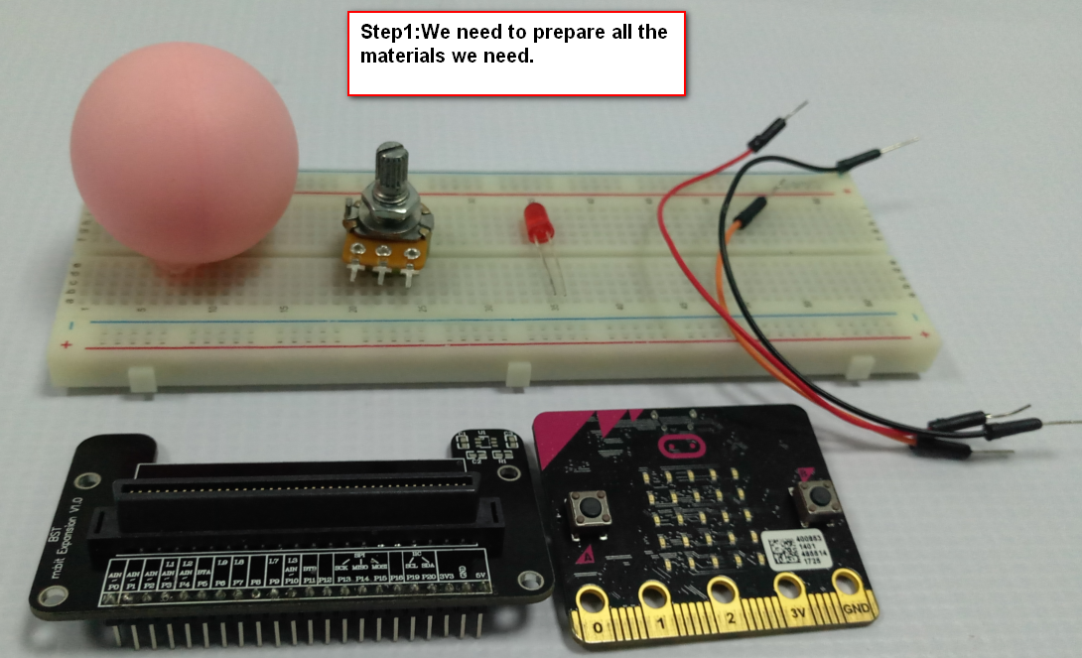
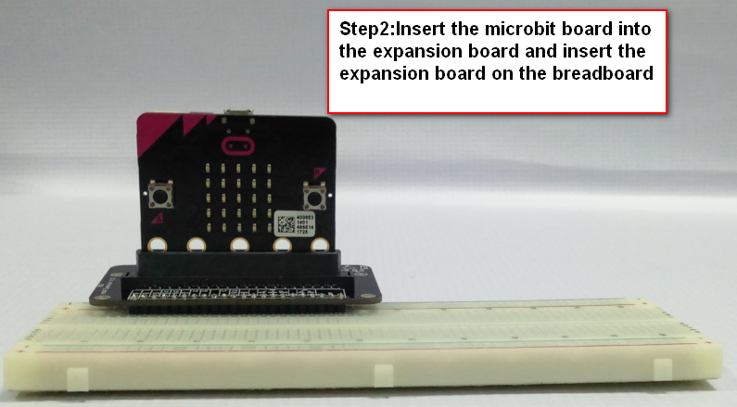
micro:bit entry video tutorial
Part 3
Handmade
YahBoom micro:bit creative tutorial

Slide 6
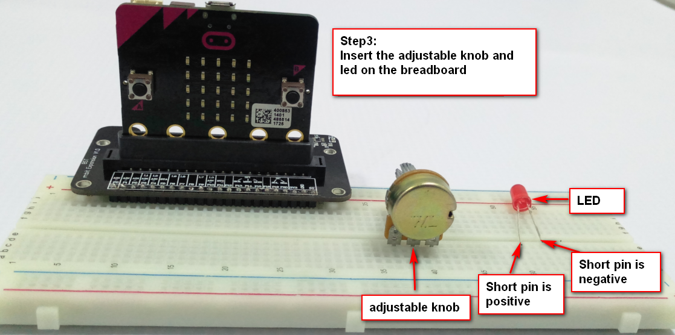
micro:bit entry video tutorial
Part 3
Handmade
Everyone must distinguish between the positive and negative poles of the led light.
The positive pole is connected to the VCC of the power supply, and the negative pole is connected
to the GND.
(In this course, the positive pole is connected to the P1 pin of the expansion board,
and the negative pole is connected to the GND pin of the expansion board.)
YahBoom micro:bit creative tutoriaL

Slide 7
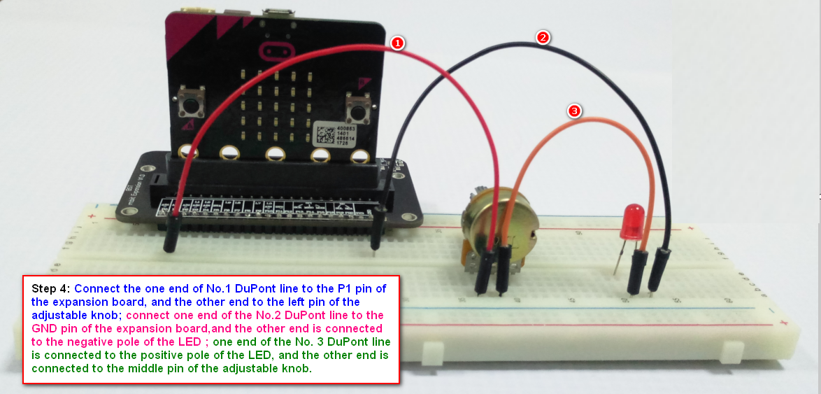
micro:bit entry video tutorial
Part 3
Handmade
Tip: The correct way to connect the adjustable knob is to connect it to the left and
middle pins, or connected to the right pin and the middle pin.
At the same time, the left pin and the right pin are unadjustable.
YahBoom micro:bit creative tutorial

Slide 8
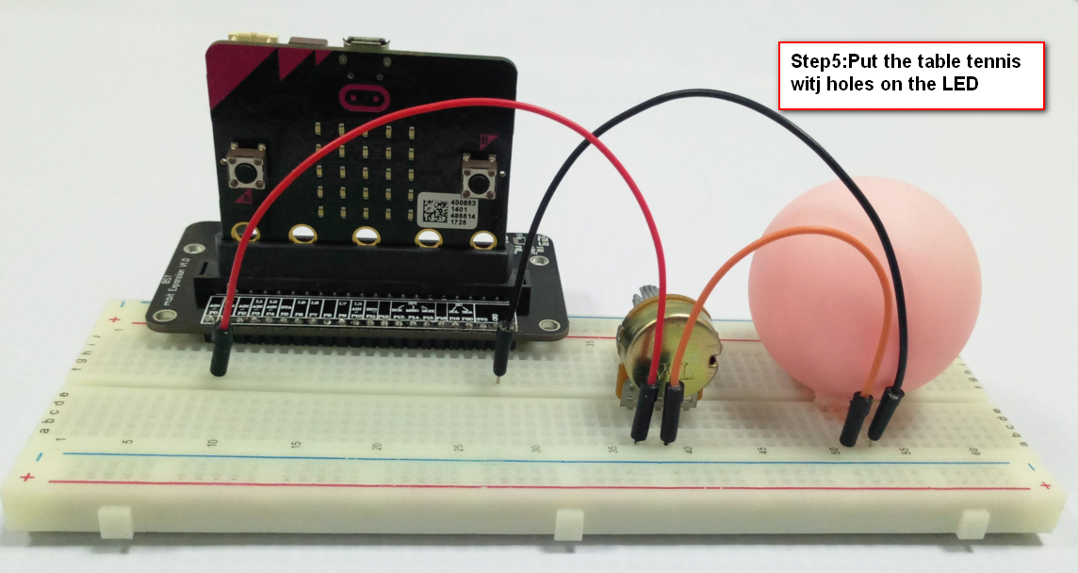
micro:bit entry video tutorial
Part 3
Handmade
In this case, our ball small lights will be ready~
After powering it up and downloading the program, it will light up.
Led lights will be randomly assigned to everyone, there are yellow, red, green and so on.
YahBoom micro:bit creative tutorial

Slide 9
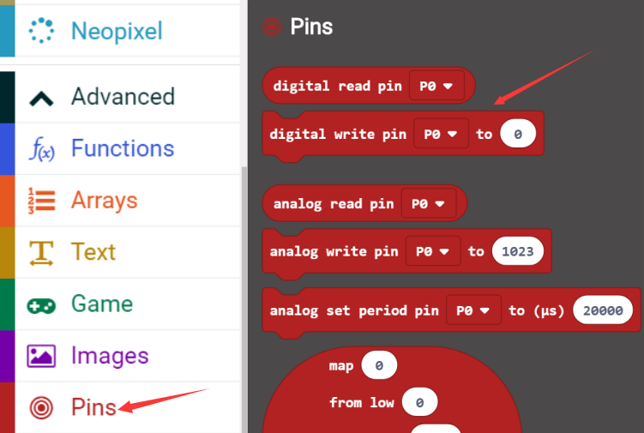
micro:bit entry video tutorial
Part 4
Search for
blocks
YahBoom micro:bit creative tutorial

Slide 10
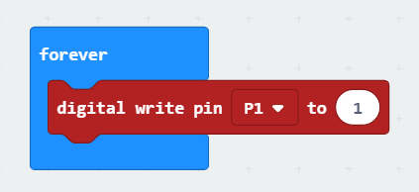
micro:bit entry video tutorial
Part 5
Combine
blocks
YahBoom micro:bit creative tutorial

Slide 11
micro:bit entry video tutorial
micro:bit
project
Thanks for watching!
Powered by
YahBoom
YahBoom micro:bit creative tutorial

